Slide 1
EggBeater
Sam Adams
Taha Ainaddin
Andrew Barton
Robert Beam
Yuki Ishikawa
Sterling Miller
Sam Whitsett

Slide 2
Design

Slide 3
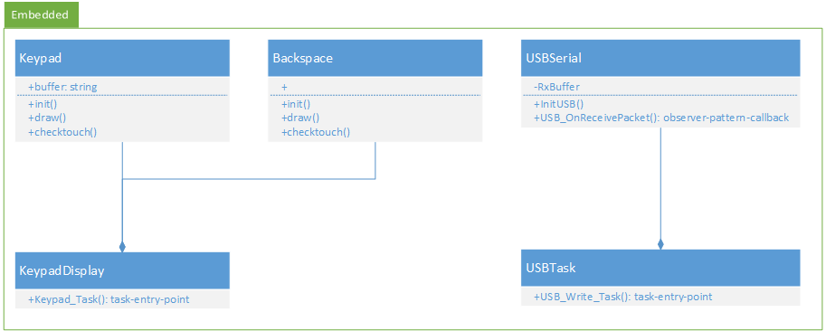
Design: Embedded

Slide 4
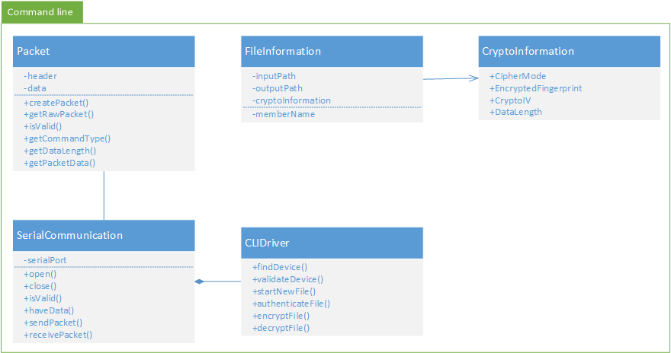
Design: Command line

Slide 5
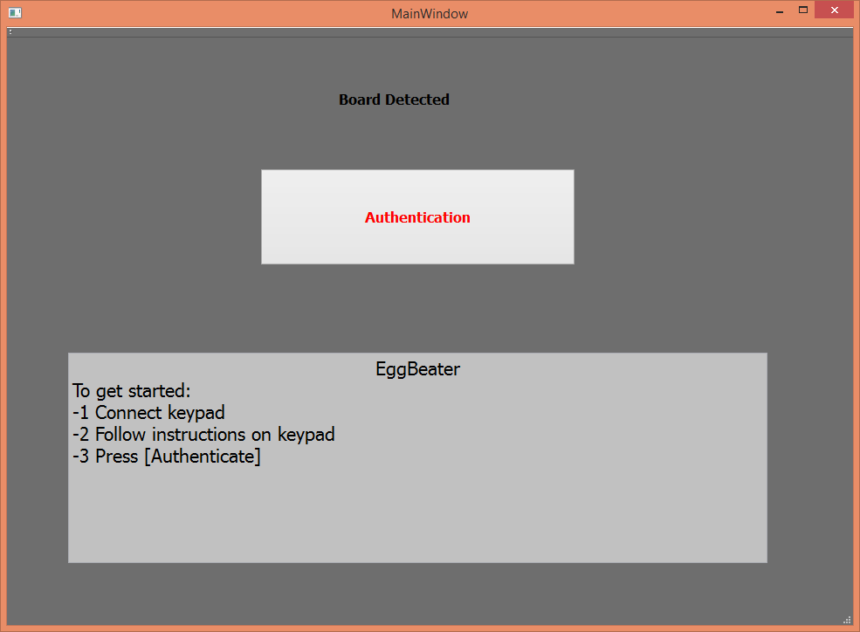
GUI mockup

Slide 6
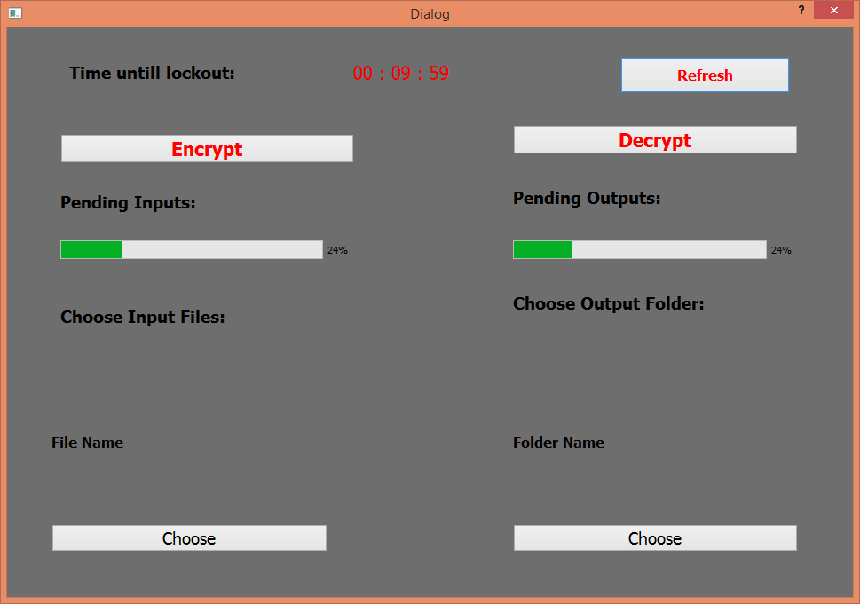
GUI mockup (cont)

Slide 7
Progress
Embedded->PC serial communication
Keypad on embedded board
Initial crypto mockup
Initial GUI mockup
Serial device discovery

Slide 8
Progress (cont)

Slide 9
Backlog
Embedded/PC packet processing
Create
Validate
Extract
GUI->Command line interaction
Discover device
Create crypto information
Encrypt file
Decrypt file

Slide 10
Testing

Slide 11
Maintenance

